Slide 1
SMART AGRICULTURE
SMART IRRIGATION SYSTEM

Slide 2
PROBLEM STATEMENT:
In the case of traditional irrigation system water saving is not considered.
Since, the water is irrigated directly in the land, plants under go high stress from variation in soil moisture, therefore plant appearance is reduced.
The absence of automatic controlling of the system result in improper water control system.
The major reason for these limitations is the growth of population which is increasing at a faster rate.
At present there is emerging global water crisis where managing scarcity of water has become a serious job.
This growth can be seen in countries which have shortage of water resources and are economically poor.
So this is the serious problem in agriculture area.
So we want to design an Smart Irrigation System which is based on PROTEUS software programming using arduino microcontroller that operate automatically by sensing the moisture content of the soil and turn ON/OFF the pump using relay without the intervention of farmer and hence save water.

Slide 3
PROPOSED SOLUTION :
In this model, Smart Irrigation System is based on arduino microcontroller..
This prototype monitors the amount of soil moisture content in soil.
A predefined value of soil moisture is set and can be varied with crops.
In case the soil moisture of the soil deviates from the specified range, the watering system is turned ON/OFF.
In case of dry soil, it will activate the irrigation system, pumping water for watering the plants.
This project is mainly based on PROTEUS based software C programming language.
In simulation, pin2 and pin3 are used as a input pin for DC motor and switch respectively.
This system can be implemented on a large scale for farming purposes, which can further prove to be more advantageous.
Owing to prevailing conditions and water shortages, the optimum irrigation schedules should be determined especially in farms to conserve water.

Slide 4
METHODOLOGY :
Crop monitoring application consists of two sensor node image sensor and environment parameter collector.
These two sensors collect the information about crops.
Image sensor collect crop growth, height and second sensor node collect data about humidity, soil condition, etc and this information is collected at base station and then get transfer to internet (web application).
Data analysis is get done at server side.
Communication is duplex GPRS/CDMA type.
RF transceiver is used for communication purpose between to nodes.
This application was deployed in Beijing, Henan and Shandong Province for experimentation purpose and temperature, humidity and images of crop data are collected from these location. Application is for agriculture informationization. IOT make it possible.

Slide 5
HARDWARE COMPONENTS :
Node MCU
Soil moisture sensor
PIR motion sensor
Relay module
Bread board
Jumper cables
12v Battery

Slide 6
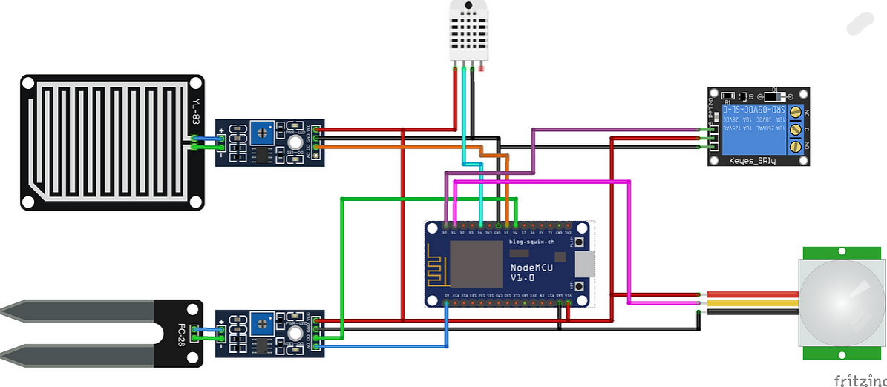
CIRCUIT DIAGRAM :

Slide 7
CODING :
https://github.com/Pradeepkumar0246/SMART-IRRIGATION-SYSTEM.git

Slide 8
CONCLUSION :
The Project ‘Smart Irrigation System’ is used for the optimization use of water in agricultural field without the intervention of farmer by using soil moisture Sensor that senses the moisture content of the Soil using Microcontroller that turn ON/OFF the pump automatically according t the need of water for irrigation and hence helpful in saving water.
This system is quite affordable and feasible.
This system of irrigation is also helpful in the region where there is scarcity of water and improves their sustainability.
And can also be adjusted according to the need of varieties of crop to be irrigated.

